Slide 1
Analysing Citation Networks
Programming Task Report

Slide 2
Overview
I attempted all three programming tasks, in decreasing levels of depth due to time and learning constraints. I completed a full exploratory data analysis with interesting insights, investigations, hypotheses and reports. I performed basic static and community detection programs and compared two algorithms for static community detection, both theoretically and performance based. For temporal community detection I used one method to plot community count over years. For the bonus task, I implemented a GNN method and an algorithmic method (Node2Vec) and used an AUC score to compare efficiency between the two. I reported my understandings of the same.

Slide 3
Understanding the dataset
My pre-existing knowledge
The dataset given is by SNAP: Stanford Network Analysis Project
The High-energy physics citation network contains a graph represented by edges, edge i to j means that paper with ID i cites paper with ID j. It is a directed graph. Also provided is the dates of submission of all papers to Arxiv. The task objective is to analyse this data as a network.
At the time of starting the task, my skills and knowledge related to the task and its domains comprised of:
Basic graph theory
Elementary python proficiency

Slide 4
Part 1: Exploratory Data Analysis
After understanding the task objective and researching on how to perform exploratory data analysis, I started studying implementation of libraries used for the same. Some of them are Pandas, NumPy, networkx, matplotlib.
After that, I created a graph representation of the data, using a directed graph to represent the nature of citations. From preprocessing the citation network file, I obtained the following details:
Node count: 34546
Edge count: 421578
Maximum NodeID= 9912553
Minimum NodeID= 1001
The node count and edge count corresponds to the details mentioned in the dataset source.

Slide 5
Processing dates:
On reading the citation dates file, it was mentioned that cross-referenced papers were prefixed with “11”. So I kept this in mind while cleaning and reading data. After processing, the following details were obtained:
Raw count of papers in date dataset: 37621
After cleaning: 30561
Undated papers: 3985
Range of papers in net: 1992-02-11 00:00:00 to 2002-03-12 00:00:00
According to this, there are 3985 undated papers. For these papers, I initially created an estimation method that used the median of the neighbours of the node as an approximate date. However this method revealed that there were some nodes that were only neighbouring undated nodes- this entire set of nodes had no dated neighbour.

Slide 6
Initially I decided to omit these nodes from the network, but after consideration later I realised they could represent a community of papers with certain shared properties that would be interesting to perform community detection on. So I decided to estimate these nodes on the median of all known nodes. This comes with limitations- could cause accumulation of nodes around the median, but since the number of these nodes were relatively low (of the order of 10), I decided to stick with this approach. I also decided to create a backup reference dataset with only nodes whose original dates were provided. I then tested this on 5 sample subsets of data and obtained the following:
Estimation method took less than 30 seconds to run for a dataset ~ 30,000 nodes for 3800 missing node dates.
Deviation from actual data (in days):
Min: 0
Max: 3510
Average: 599.2062105263158

Slide 7
The estimation method has extreme outliers in terms of accuracy, being able to estimate to almost exact equality, and having estimates with an offset of around a decade. This is a wild-card method to deal with missing data, however I am interested in its implications and will conduct analyses on this dataset. This also affirms my initial thoughts for need of a reference set.
I performed this estimation on the dataset, and now all 34546 nodes have dates.
Nodes with only undated neighbours:
: {208197, 301132, 301100, 211183, 205169, 208052, 210325, 302197, 302100, 209304, 207130, 301083, 302172}
I saved these as “special nodes”

Slide 8
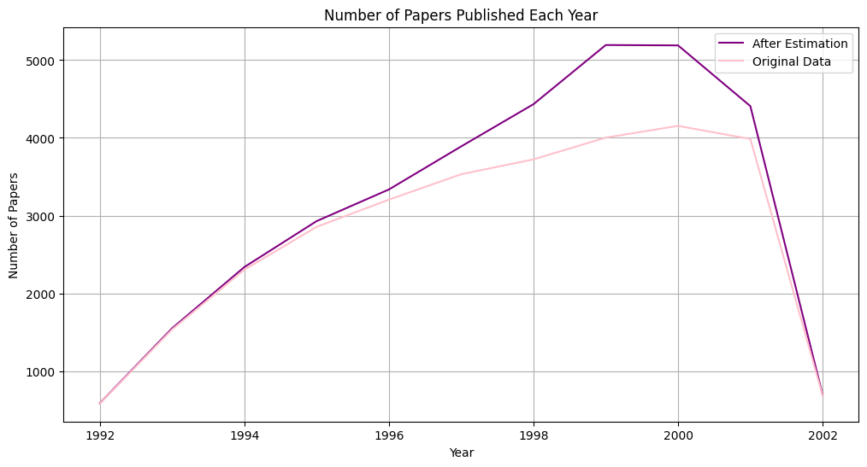
Papers published per year:

Slide 9
Papers published per year:
The dip around 2002 is attributed to the range of papers in the network. During data pre-processing this was found to be: 1992-02-11 to 2002-03-12. The graph does not account for papers published in the remaining months of 2002 and forth, hence misrepresents the number to be quite low.
As expected, overall the estimated graph traverses higher values as it contains more nodes than the reference.
Alot of the peak difference is around the 2000-2002 area, which indicates a lot of undated nodes were attributed to that time period. The undated nodes could have something in common that groups them- perhaps they belong to a subset of HEP that was highly concentrated on during the 2000-2002 period.

Slide 10
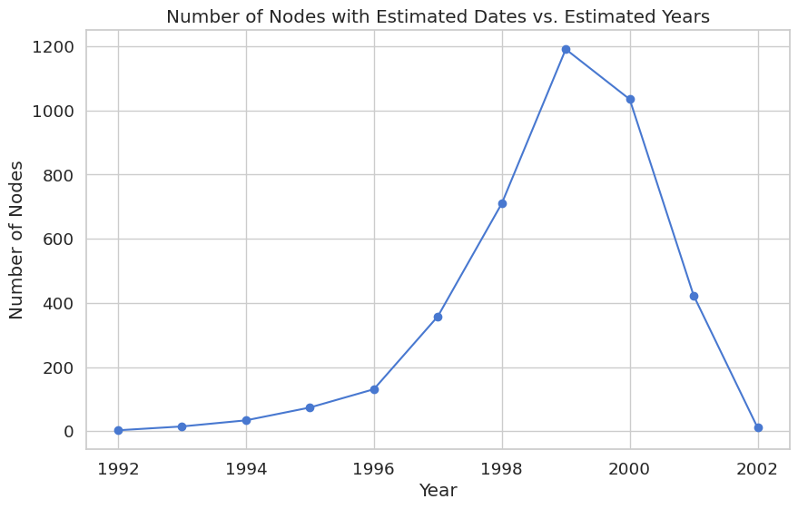
2) Number of undated nodes vs years they were estimated to
To test this, I want to visualise what portion of the undated nodes were estimated to the time range 2000-2002:
This confirms the hypothesis as the peak of the graph coincides with the largest difference in the other graph between the estimated and original line plots.

Slide 11
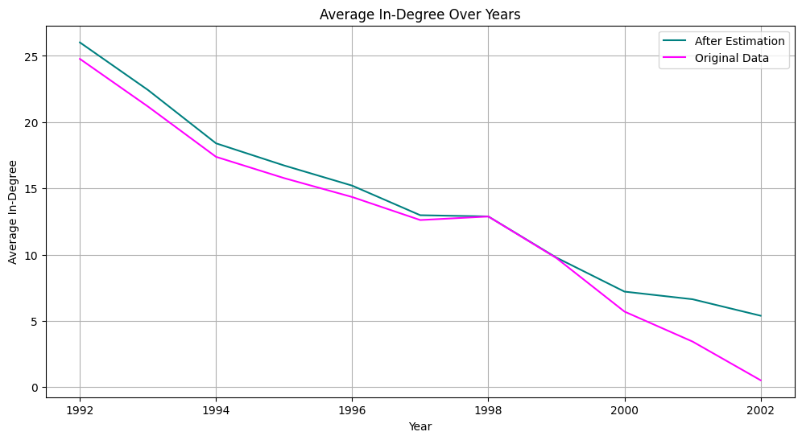
3) Average In-degree over years
Next analysis would be average in-degree of each paper in each year: how much does each year's research form as reference for future works?

Slide 12
To examine this hypothesis, I will compute the normalised average in-degree over time. The normalisation method is dividing by the years since publication from the latest year in the dataset range, i.e., 2002. The normalisation still might not give an entirely accurate representation of the accumulation of citations. The data is analysed with this limitation in mind.

Slide 13
The reason for the variation between the two is again, as detailed for the last plot. The graph again mostly varies towards the end, from the period 2000 to 2002. The graph cannot be analysed directly as earlier papers have bias because they have been available for longer compared to later, more recent papers.
It may not be indicative of the importance or relevance of the papers themselves. That is why there is an overall almost linear decrease in in-degrees with respect to time.

Slide 14
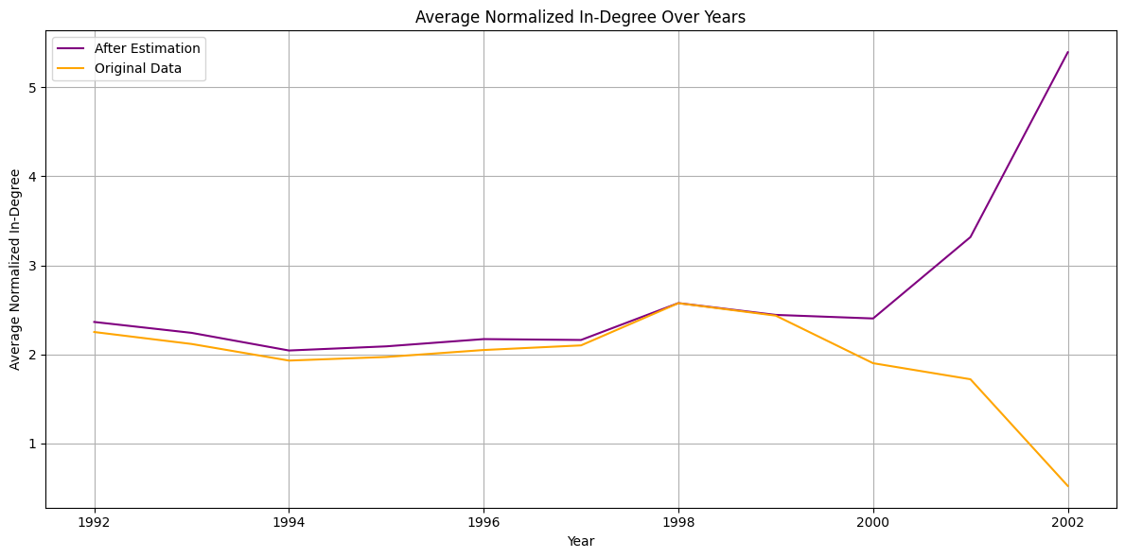

Slide 15
4) Average Normalised in-degree over time
As expected, the decrease in citations was due to age bias, and not due to relevance of the older papers themselves. However after normalization, the extreme difference between the two plots is highlighted for the period 2000 to 2002: this could indicate that a lot of missing dates were estimated to be around this period. Perhaps these nodes belong to the year 2002, after the month of march (last recorded month in dataset).
However, even if the estimation method favored larger number of papers for the 2000-2002 period, the plot for papers published per years decreases quite similarly to the reference data indicating that the increase in average in-citations is not due to the increase in papers- perhaps it documents a shift to a new direction of study that increases citations for papers within that area. Or, perhaps these papers represent a pivotal discovery that catalysed similar papers, creating higher citations.
It could also be an issue with normalisation method. I want to analyse this interesting observation further before moving on to other properties. To do this, first I want to obtain highest values of in-degrees over the years 2000 t0 2002.

Slide 16
Highest In-Degree Nodes (2000-2002):
Year | Highest node from estimated dataset | Corresponding in-degree | Highest node from original dataset | Corresponding in-degree
2000 | 6124 | 216 | 6124 | 134
2001 | 106528 | 184 | 102122 | 136
2002 | 201231 | 98 | 201231 | 19
Interestingly, the highest in-degree node remains the same for both datasets.(excluding 2001), but with a shocking increase in in-degree in each case, indicating that alot of missing-date nodes cited these particular papers.

Slide 17
One final check before moving on to the rest of the features: I want to understand qualitatively the field of these papers and why they correlate to these estimation anomalies. Perhaps I can come to a conclusion about the nature or reason for the missing date nodes.
Paper 6124, that had close to a double number of citations in the estimate compared to the reference dataset is titled:
QCD factorization for exclusive, non-leptonic B meson decays: General arguments and the case of heavy-light final states
Paper 201231, which had around a five times increase when estimation was applied, is titled:
Evidence for Neutrinoless Double Beta Decay
I would like to investigate the second data finding a little further.
For this I want to collect all the papers that are undated, that were estimated to 2002

Slide 18
Hypothesis: Date revision discrepancy:
On reference to the ArXiv HEP-PH database, it was found that all of these papers were almost direct conclusions and developments on the Neutrinoless Double Beta Decay topic- and all of these had publication dates a little after the last date recorded in the dataset, ie. March 2002. Alot of these papers have multiple revised publication dates.
This is also corroborated by the fact that the estimation method I designed attributed alot of the missing papers to the later period (close to the 2000s).
Perhaps each group of missing date nodes are related to one particular foundational paper that is dated and properly connected to the network. Since the dataset mentions explicitly that it excludes papers outside the time range, maybe these papers were first published within the range, but underwent multiple revisions and the revised dates exceeded the upper bound date of the dataset.
Building on this, the "special nodes" set could indicate another such experiment or niche that developed during the 2000 to 2002 timeframe whose all papers underwent the date-revision discrepancy.

Slide 19
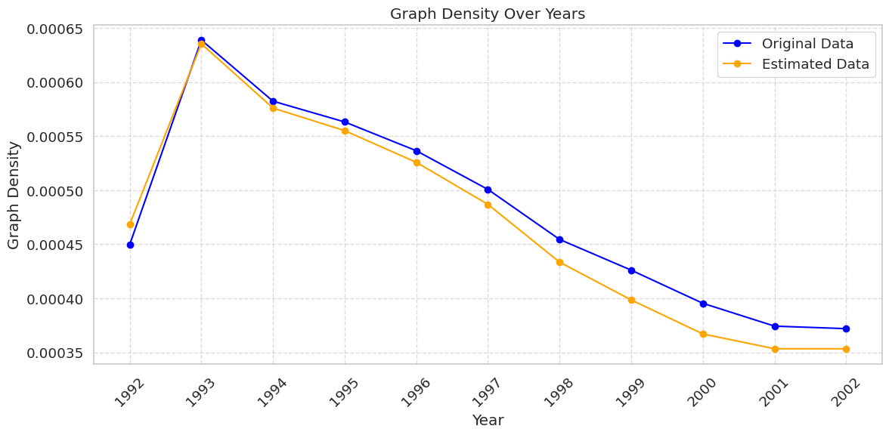
5) Density of graph over time

Slide 20
Both datasets exhibit a lowering density indicating that the graph is a highly sparse network- this is characteristic of citation networks as each paper references only relevant papers. Like other trends, the estimated dataset shows increase in density towards the 2000-2002 period, likely attributed to the estimation method and the date-revision discrepancy hypothesis. Since the estimation process adds node dates based on neighbours (except special nodes), estimation would also increase the edges and connections hence graph density.

Slide 21
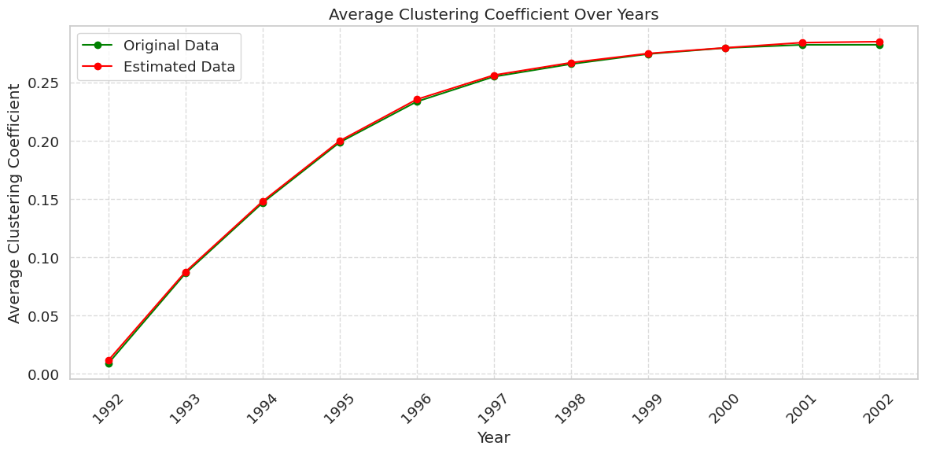
6) Average clustering coefficient over time

Slide 22
In graph theory, a clustering coefficient is a measure of the degree to which nodes in a graph tend to cluster together. The increase in clustering coefficient likely indicates that research is becoming more specialized, with researchers frequently citing papers within a focused subfield. It indicates change in direction of the field HEP from a cohesive field towards an aggregation of specialised and considerably isolated research areas with limited cross-referencing. It shows development and organization of research with time. It is an interesting visualisation that demonstrates the evolution of dynamics within research in the particular field over time. The stagnation around the 2000s period aligns with previous findings indicating a shift in focus of research during that period, probably due to pivotal or groundbreaking discoveries.

Slide 23
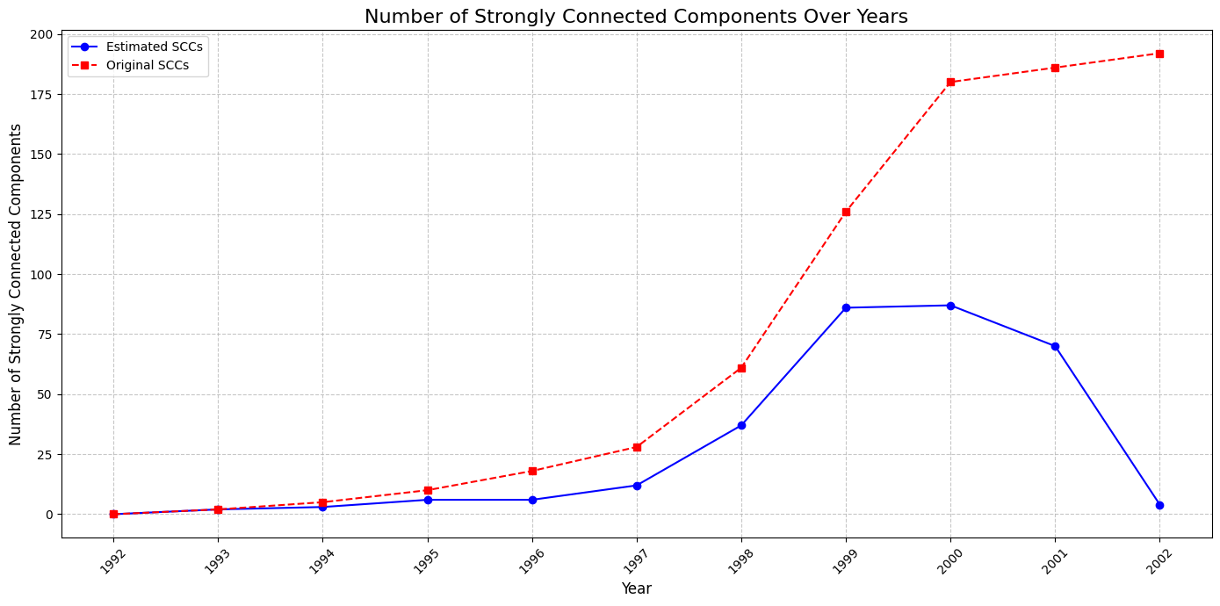
7) Number of Strongly connected components over time:

Slide 24
Analysis: To understand dynamics of directed interaction (relevant for citation network) I chose strongly connected components over weakly connected components as a metric to observe of the graph over time. The increase in number of strongly connected components till 2000 shows the presence of distinct research communities and interdisciplinary collaborations culminating. The decrease in original dataset shows that the previous fields have consolidated their findings and strongly connected componenets (specialised subfields) perhaps merge in their research. However, the original dataset excludes certain nodes, that we have previously hypothesized to represent specific niche and isolated areas of research within HEP from 2000 onwards. This is illustrated by the incredible increase in number of SCCs in the estimated data plot. If this hypothesis is true, there should be a good increase in the size of SCCs from 2000 for the orginal dataset representing the merging of SCCs. Similarly, the SCCs should decrease in size for estimated data plot to show the emergence of new tiny subfields. Rather it should stagnate, as the large size of culminated fields from before 2000s averages out the smaller size of emerging niches.

Slide 25
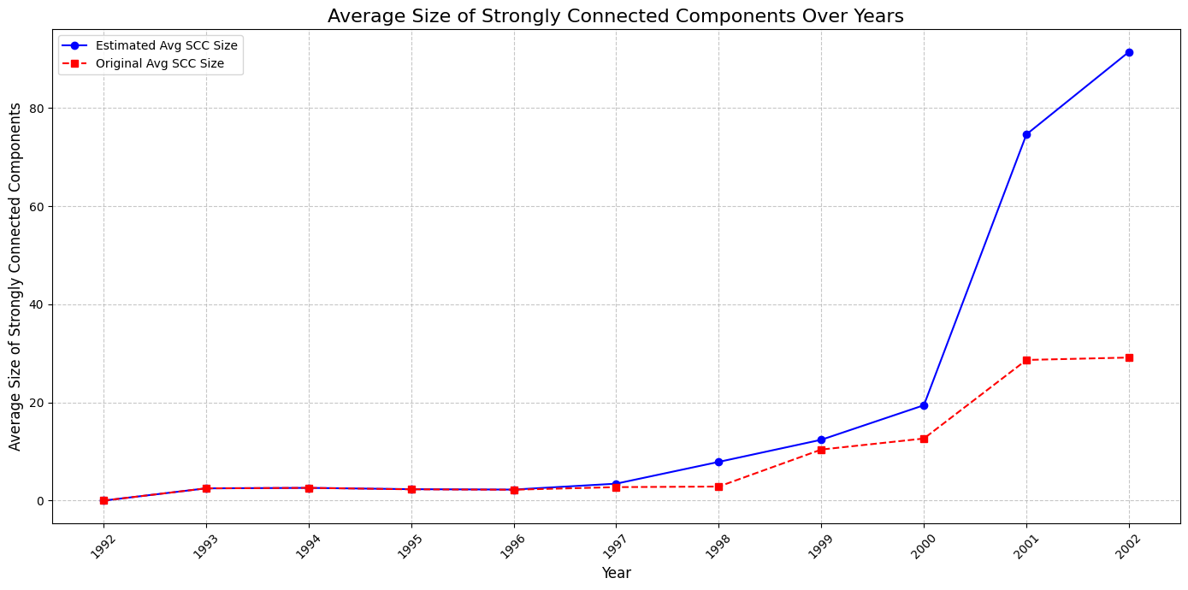
8) Average Size of Strongly connected Components over time

Slide 26
My predictions were accurate, validating my hypothesis about the trajectory of research in HEP-PH post 2000.

Slide 27
Task outcome.
Discovery of set of “special nodes”: could indicate a new specialisation cluster in 2001 to 2002 time period.
Formulated a hypothesis for missing node date information.
Determined the trajectory of area of study in HEP from 1992 to 2002:
Steady increase in specialised fields from 1992 which culminated into a cohesive research in 2000
Emergence of new, unrelated areas of study post 2000 that shifted the trajectory from the previous culmination of work.

Slide 28
Part 2: Community Detection
After the exploratory data analysis, not only did I gain an understanding of this particular citation network, but I also gained proficiency in data related libraries such as networkx, matplotlib, pandas and numpy. In order to perform community detection, I first investigated the concept and its methods of implementation.
For time T, I chose 2000, a year that stuck out in terms of patterns and trajectories in my exploratory data analysis. For this time T, I implemented two algorithms for community detection. One was Label Propagation method, and the other was Louvain algorithm. After trial and error, I found these methods to be most effective considering size of dataset.
After that I performed temporal community detection utilising Louvain Algorithm to observe community evolution over time.

Slide 29
Static community detection
Static community detection:
I will demonstrate two methods on the graph at a chosen snapshot (time T).
T = 2000, i.e, I will use the subgraph of papers published on or before 2000.
(Note: According to the exploratory data analysis hypotheses 2000 represents the culmination of different subfields research into a consolidated field of interconnected study.)
Subset Graph at Time T=2000:
Snapshot at 2000: 25893 nodes, 265032 edges

Slide 30
Label Propagation method
This method works on the premise that in a network, nodes tend to belong to the same community as their neighbours. Initially, each node receives a label and is consequently continuously replaced with the most frequent label amongst its’ neighbours. This continues till labels stabilize.
This method is very efficient for citation networks as nodes and their neighbours often belong to the same of related area of study. However this method fails to account for overlapping communities - that is, if papers are interdisciplinary or cross-referenced.

Slide 31
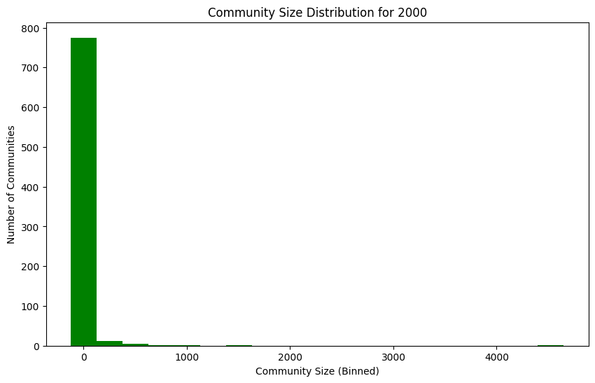
Label propagation implemented at T=2000
Label Propagation found 796 communities. Plotting sizes of these communities:

Slide 32
Most communities are relatively small, between the size of 0 to 2000. However there is a tiny sliver of size >4000. The first chunk could represent the emerging new fields that were predicted to occur in 2000, and the second chunk represents the consolidated network of all previous work before the trajectory shift.
Since this method works on neighbours, this hypothesis makes sense.

Slide 33
Louvain method
The louvain method uses modularity as a measure to optimize formation of communities. Modularity compares the actual density of edges within communities to what would be expected if the edges were randomly distributed. Higher modularity values indicate a better-defined community structure. First, it optimizes locally: seeing if modularity improves if nodes are moved to a neighbouring community. Then once no more optimizations can be made, all nodes in a community are aggregated into a node, and a coarser graph is obtained on which the process repeats. This works well for citation network as each node is an aggregate of nuanced nodes in a community, i.e. it represents a hierarchy of fields and subfields within an area of research.

Slide 34
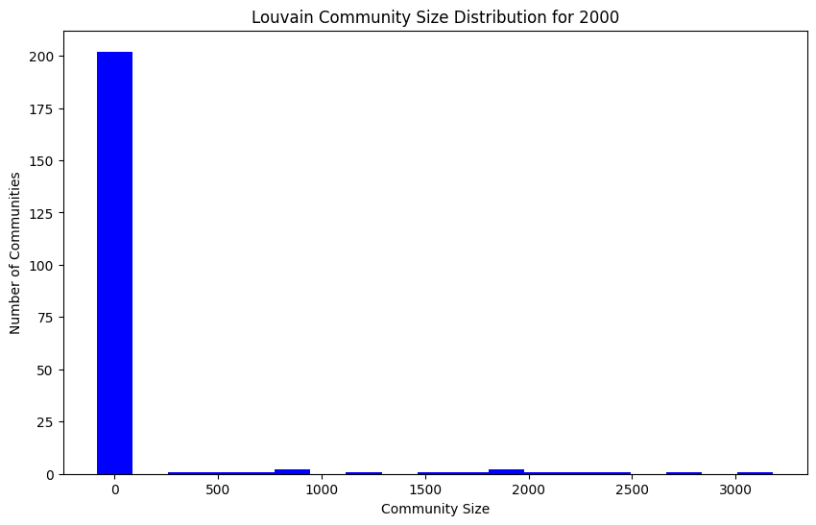
Louvain method implemented at T=2000
Louvain found 217 communities. Plotting sizes of these communities:

Slide 35
This is more distributed than the LP plot, however it still reflects the overall structure of communities in the year 2000: one massive chunk representing previous consolidated study, and smaller, isolated pieces of newly emerging fields and areas. Since Louvain method optimizes modularity, overall it returns a lesser number of communities however each community with more density.

Slide 36
Temporal community detection:
Temporal community detection is the process of finding communities (groups of nodes) in a network that evolve over time. Since modularity is a good metric for community structure, I decided to use Louvain method for temporal community detection.

Slide 37
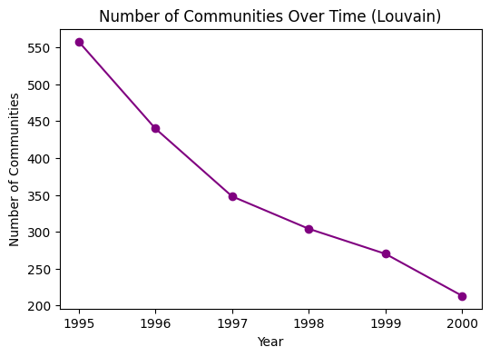

Slide 38
The sharp initial drop (1995-1996) might represent the early phase of field integration
The slower decline in later years suggests a more stable network structure emerging
The steepest decline occurs between 1995-1996, after which the rate of decrease becomes more gradual, suggesting a consolidation process.
There's a clear downward trend from about 550 communities in 1995 to around 220 communities in 2000, representing approximately a 60% reduction.

Slide 39
Part 3: Bonus task- Link Prediction
Comparing two different approaches to link prediction:
Simple GNN approach
Node2Vec
I studied the working of node2vec as part of the paper reading task and was interested in working with it practically. I implemented a basic GNN training model and node2vec for a time T = 2000. I implemented AUC (Area Under the Curve) as a performance metric to evaluate both methods and GNN surpassed N2V greatly.

Slide 40
AUC scores
Interpretation:
0.5: Model performs no better than random guessing.
>0.5: Model has predictive ability.
Closer to 1: Better model performance.
AUC measures How well the model distinguishes between positive and negative samples.
Positive Samples: Existing or future links.
Negative Samples: Non-existing links.

Slide 41
GNN uses an adjacency matrix for G_train and a small neural architecture.
Node2Vec: generate embeddings, sample negative edges, train a simple predictor, and evaluate on test edges.
AUC scores: Node2Vec AUC: 0.0026, GNN AUC: 0.4622
GNN outperforms N2V.
Node2Vec embeddings capture structural roles. Good performance often depends on walk-based exploration of the graph structure.
A GNN can exploit neighborhood information more directly.

Slide 42
A GNN uses the adjacency matrix and message-passing mechanisms to directly collect information from neighboring nodes. This allows it to capture both structural and feature-based relationships making it better at context related tasks like link prediction.
Node2Vec, on the other hand, relies on random walks to explore the graph structure, which may miss important local connections or dependencies critical in citation networks.

Slide 43
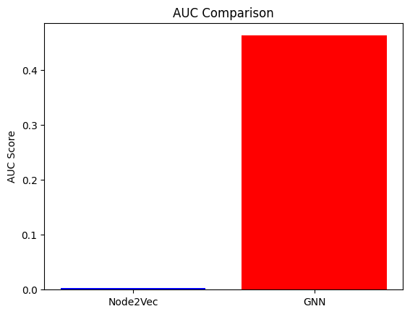
AUC scores:

